Slide 1

Artificial Neural Network: Vanishing Gradient
Mina Farmanbar
Associate Professor, University of Stavanger
for engineers

Slide 2
Vanishing gradient problem
We will discuss a problem with the sigmoid activation function that prevented neural networks from booming sooner.
This problem is the vanishing gradient problem.

Slide 3
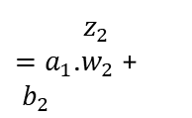

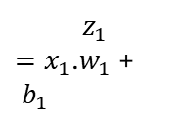







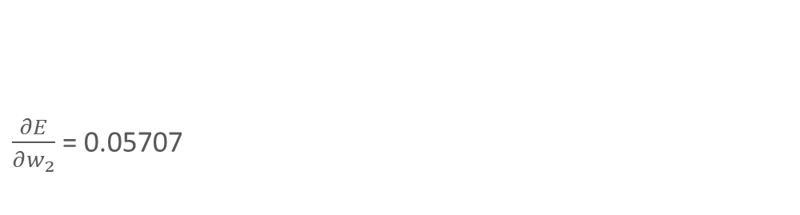
Vanishing gradient problem
T: Ground Truth = 0.25
Epochs = 1000
$α$ = 0.4
$$ε=0.001$$
$$x_{1}=0.1$$
$$a_{1}=f(z)$$
$$z_{2}$$
$=a_{1}$.$w_{2}$ + ${ b}_{2}$
$$a_{2}=f(z)$$
$$z_{1}$$
$=x_{1}$.$w_{1}$ + ${ b}_{1}$
$w_{1}$ = 0.15
$w_{2}$ = 0.45
$\frac{∂E}{∂w_{2}}$ = 0.05707
$b_{1}$ = 0.40
$b_{2}$ = 0.65
$\frac{∂E}{∂w_{1}}$ = 0.00096
((-1* (T - a2)) * (a2*(1-a2)) * a1)
((-1*(T - a2)) * (a2*(1-a2)) * w2 * (a1*(1-a1)) * x1)

Slide 4
Vanishing gradient problem
We are using the sigmoid function, then all the intermediate values in the network are between 0 and 1.
So, when we do backpropagation, we keep multiplying factors that are less than 1 by each other, and so their gradients tend to get smaller and smaller as we keep on moving backward in the network.

Slide 5
Thank you!
Mina Farmanbar
mina.farmanbar@uis.no

